Slide 1









Slide 2









Slide 3




Slide 4



Slide 5
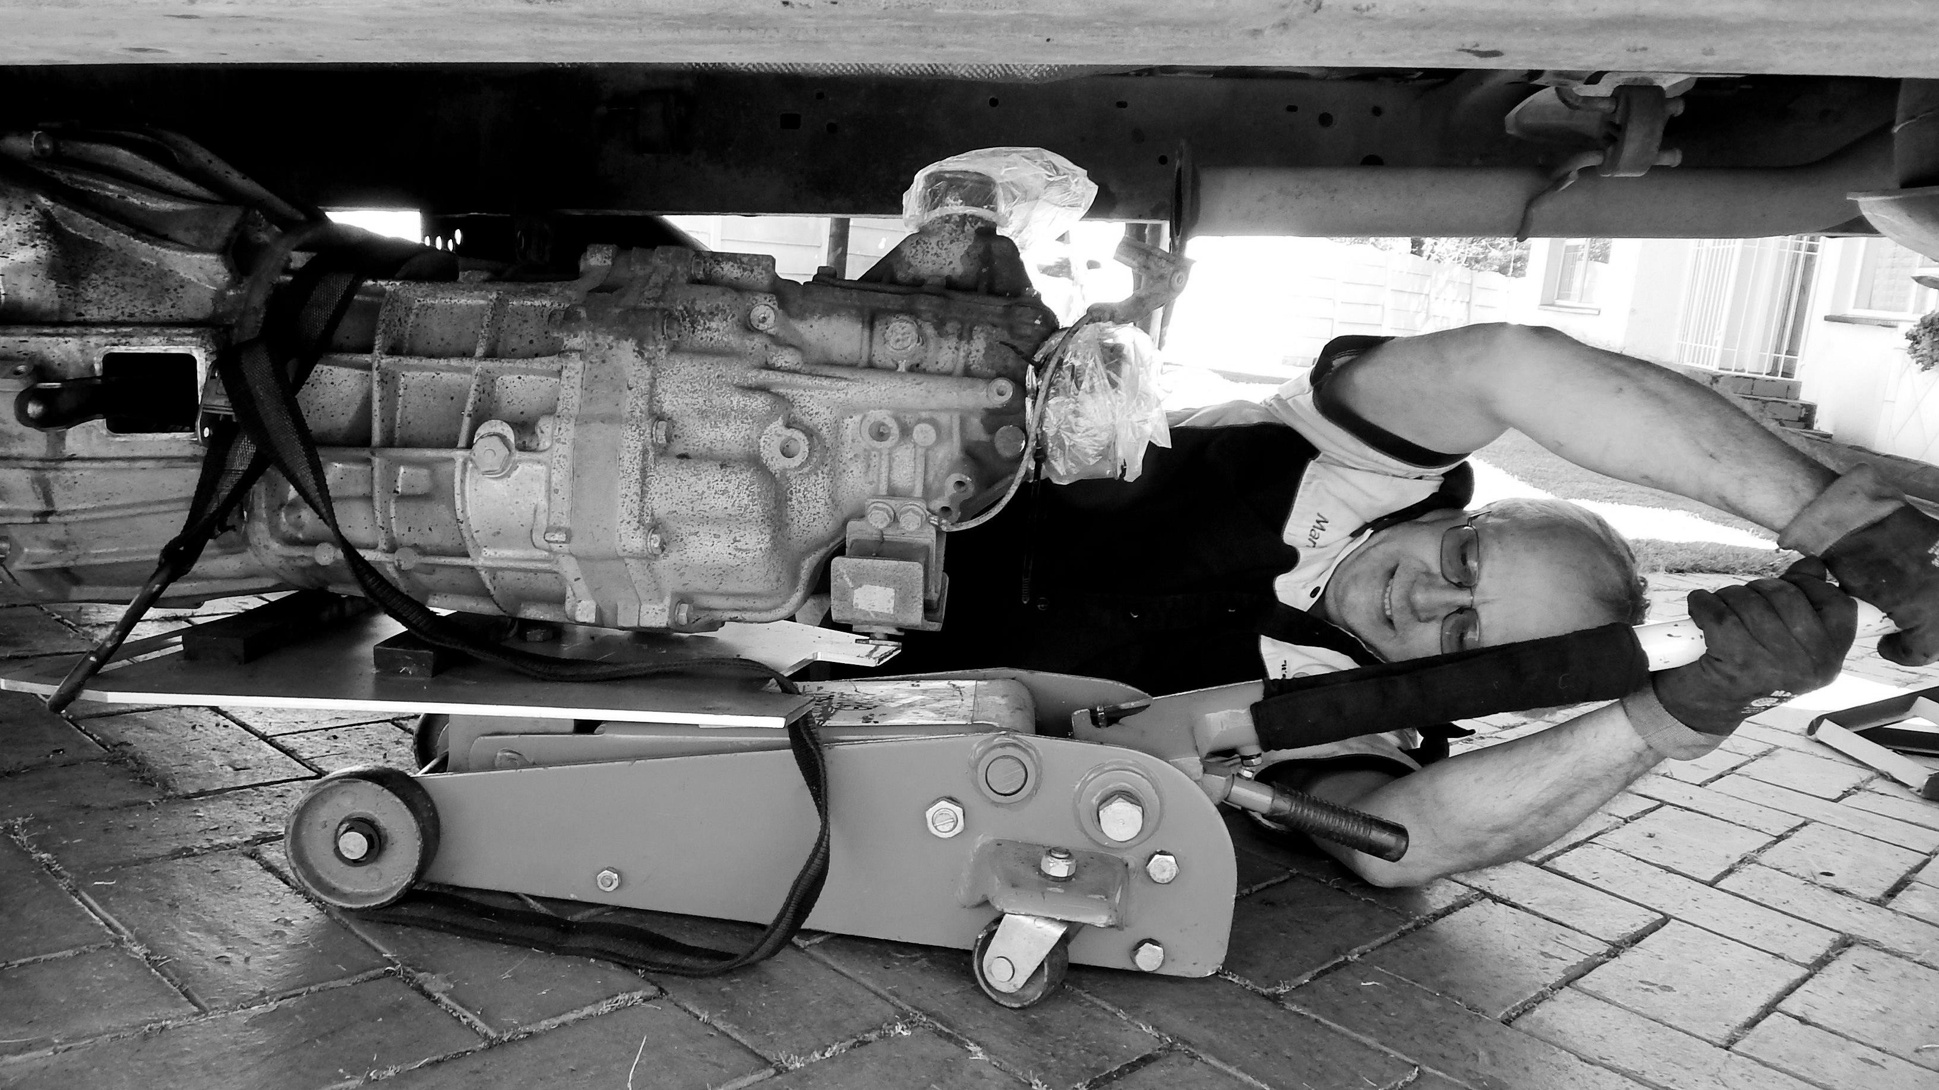


Slide 6











•
•
•

Slide 7
•
•
•

Slide 8





Slide 9
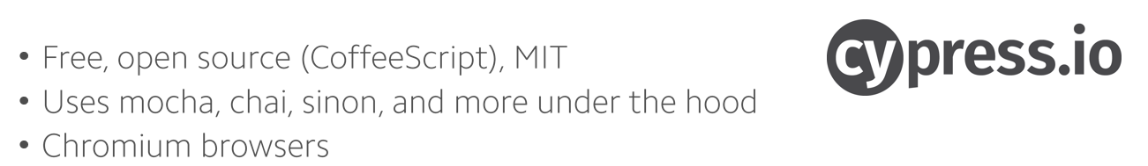
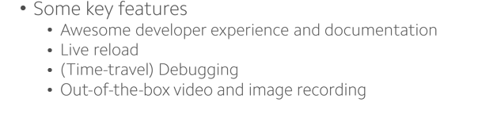
“Fast, easy and reliable testing for anything that runs in a browser.”

Slide 10
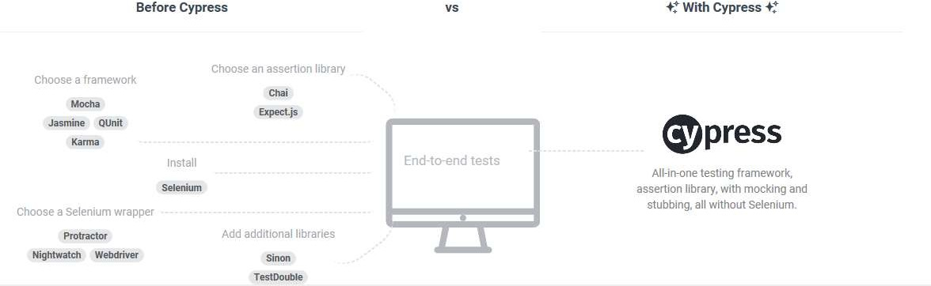

Slide 11
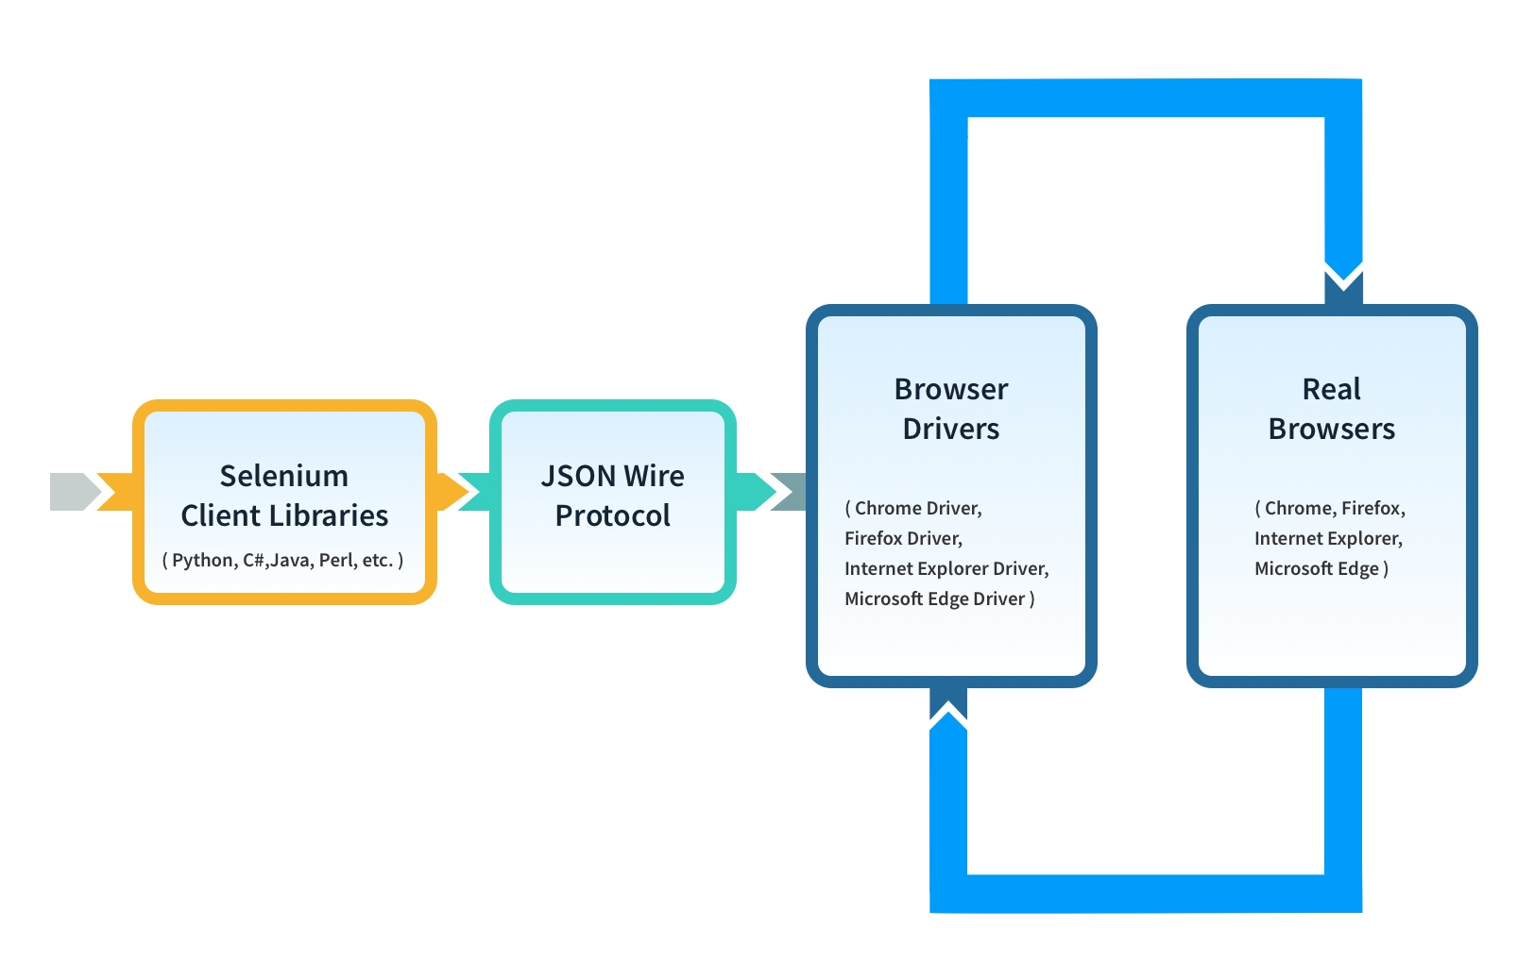

Slide 12
Configuration
Debugging
Speed
Browser support
Manual waiting

Slide 13






















Slide 14
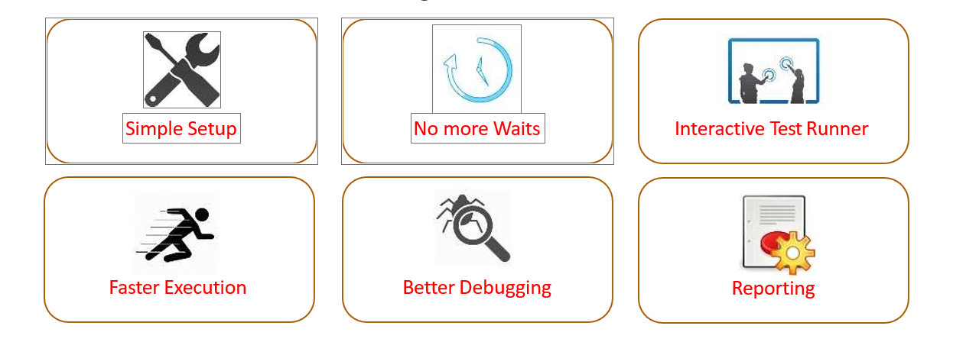

Slide 15



Slide 16



















Slide 17
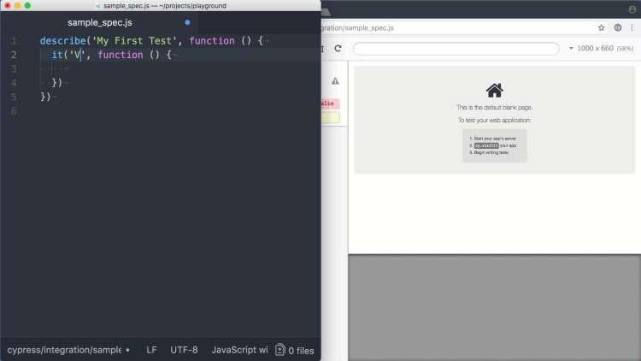
Interactive Script Execution

Slide 18
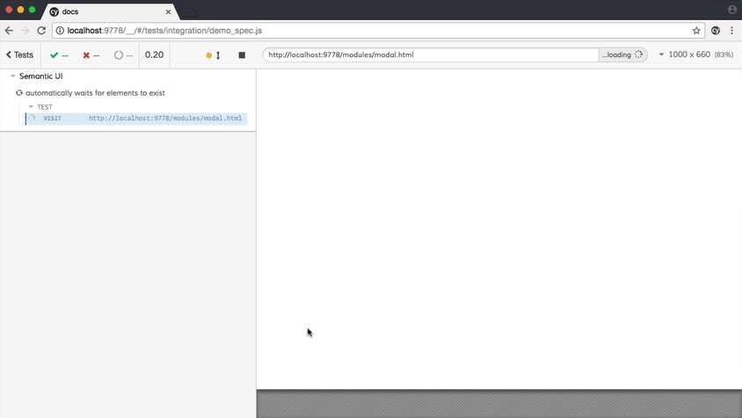
Interactive Debugging

Slide 19
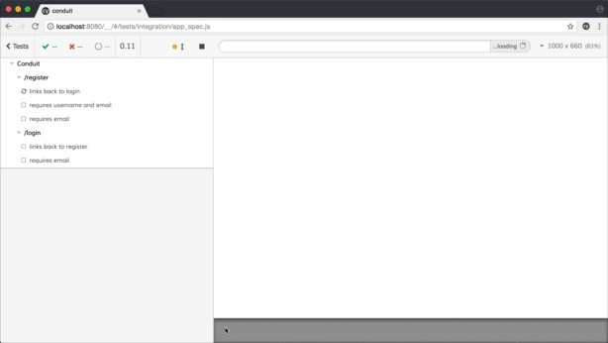
Speed of Execution

Slide 20
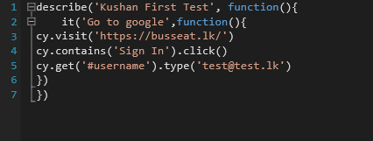
Going through the code
It’s a mocha coding style. Its like name given to the test suite. There can be multiple it statements
`it()` is a test case
Navigates to the given URL and clicks on the button with text “Sign In”

Slide 21

Limitations for Now
Supports limited set of Browsers – Chrome, Canary and Electron
Still page object model is not supported.
Bit tough to read data from files.
Third party reporting tool integration is limited.

Slide 23
START WITH CYPRESS DEMO

Slide 24
Introduction to Cucumber

Slide 25
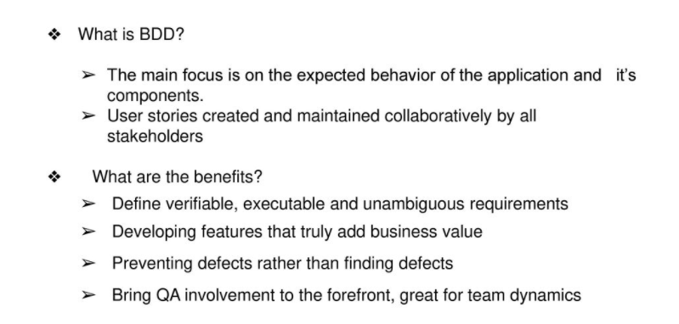

Slide 26
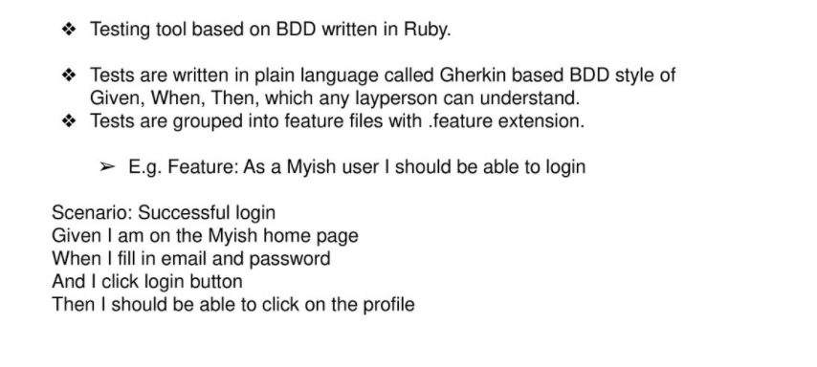

Slide 27
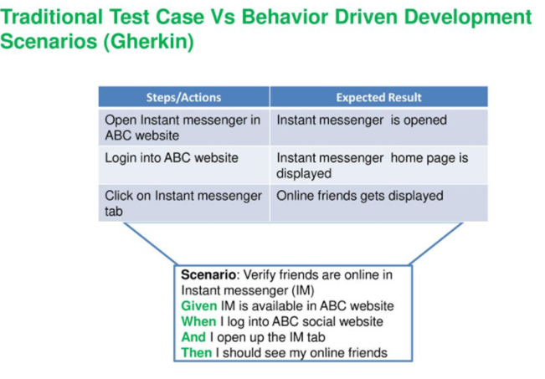

Slide 28
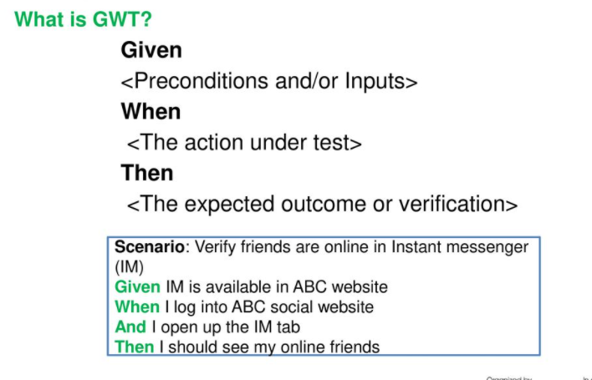

Slide 29
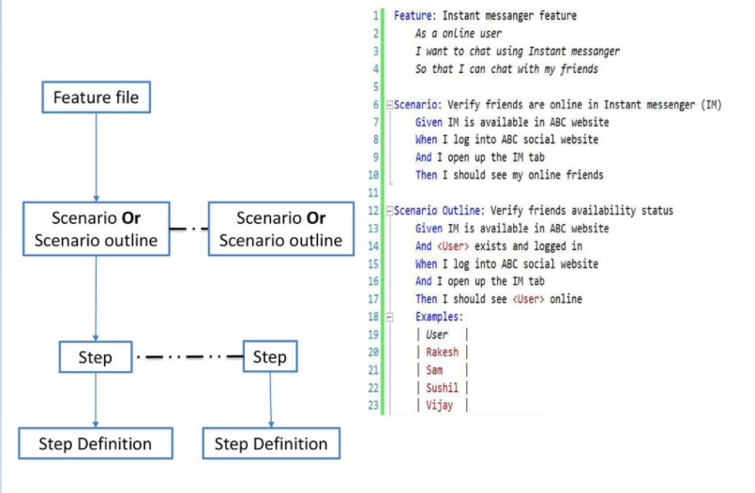

Slide 30
CYPRESS BASIC DEMO WITH CUCUMBER

Slide 31
CYPRESS
Integrated app DEMO

Slide 32
Q & A

